Slide 1




Noida Institute of Engineering and Technology, Greater Noida
Data Pre-Processing
Unit: 3
Data Analytics ACSAI0512
Dr. Kumod Gupta
CSE-AI
B.Tech 5th Semester

Slide 2
Faculty Introduction
Name | Dr. Kumod Kumar Gupta
Qualification | PhD
Designation | Assistant Professor
Department | CSE- AI
NIET Experience | 03 Years
Subject Taught | Deep Learning, Machine Learning, Programming for Data Analytics

Slide 3
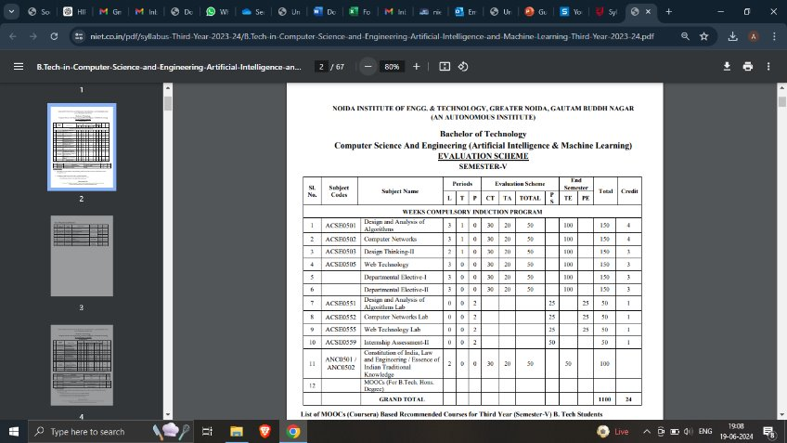
Evaluation Scheme

Slide 4
Syllabus
UNIT-I: Introduction to Data Science
Introduction to Data Science, Big Data, the 5 V’s, Evolution of Data Science, Datafication, Skillsets needed, Data Science Lifecycle, types of Data Analysis, Data Science Tools and technologies, Need for Data Science, Analysis Vs Analytics Vs Reporting, Big Data Ecosystem, Future of Data Science, Applications of Data Science in various fields, Use cases of Data science-Facebook, Netflix, Amazon, Uber, AirBnB.

Slide 5
Syllabus
UNIT-II: Data Handling
Type of Data: structured, semi-structured, unstructured data, Numeric, Categorical, Graphical, High Dimensional Data, Transactional Data, Spatial Data, Social Network Data, standard datasets, Data Classification, Sources of Data, Data manipulation in various formats, for example, CSV file, pdf file, XML file, HTML file, text file, JSON, image files etc. import and export data in R/Python.

Slide 6
Syllabus
UNIT-III: Data Preprocessing
Form of Data Pre-processing, data Attribute and its types, understanding and extracting useful variables,KDD process, Data Cleaning: Missing Values, Noisy Data, Discretization and Concept hierarchy generation (Binning, Clustering, Histogram), Inconsistent Data, Data Integration and Transformation. Data Reduction: Data Cube Aggregation, Data Compression, Numerosity Reduction

Slide 7
Syllabus
UNIT-IV: Exploratory Data Analysis
Handling Missing data, Removing Redundant variables, variable Selection, identifying outliers, Removing Outliers, Time series Analysis, Data transformation and dimensionality reduction techniques such as Principal Component Analysis (PCA), Factor Analysis (FA) and Linear Discriminant Analysis (LDA), Univariate and Multivariate Exploratory Data Analysis. Data Munging, Data Wrangling- APIs and other tools for scrapping data from the web/ internet using R/Python.

Slide 8
Syllabus
UNIT-V: Data Visualization
Introductions and overview, Debug and troubleshoot installation and configuration of the Tableau. Creating Your First visualization: Getting started with Tableau Software, Using Data file formats, connecting your Data to Tableau, creating basic charts (line, bar charts, Tree maps), Using the Show me panel. Tableau Calculations: Overview of SUM, AVR, and Aggregate Features Creating custom calculations and fields, Applying new data calculations to your visualization. Manipulating Data in Tableau: Cleaning-up the data with the Data Interpreter, structuring your data, Sorting, and filtering Tableau data, Pivoting Tableau data. Advanced Visualization Tools: Using Filters, Using the Detail panel Using the Size panels, customizing filters, Using and Customizing tooltips, Formatting your data with colours, Creating Dashboards & Stories, Distributing & Publishing Your Visualization

Slide 9
Branch Wise Applications
1.Security
2. Digital Advertising
3. E-Commerce
4. Publishing
5. Massively Multiplayer Online Games
6. Backend Services and Messaging
7. Project Management & Collaboration
8. Real time Monitoring Services
9.Live Charting and Graphing
10. Group and Private Chat

Slide 10
Course Objective
The objective of this course is to understand the fundamental concepts of Data analytics and learn about various types of data formats and their manipulations. It helps students to learn exploratory data analysis and visualization techniques in addition to R/Python/Tableau programming language.

Slide 11
Course Outcomes
At the end of course, the student will be able to:
Understand the fundamental concepts of data analytics in the areas that plays major role within the realm of data science.
Explain and exemplify the most common forms of data and its representations.
Understand and apply data pre-processing techniques.
Analyse data using exploratory data analysis.
Illustrate various visualization methods for different types of data sets and application scenarios.

Slide 12
Program Outcomes
Engineering Graduates will be able to:
PO1 : Engineering Knowledge
PO2 : Problem Analysis
PO3 : Design/Development of solutions
PO4 : Conduct Investigations of complex problems
PO5 : Modern tool usage
PO6 : The engineer and society

Slide 13
Program Outcomes
Engineering Graduates will be able to:
PO7 : Environment and sustainability
PO8 : Ethics
PO9 : Individual and teamwork
PO10 : Communication
PO11 : Project management and finance
PO12 : Life-long learning

Slide 14

CO-POs Mapping
CO.K | PO1 | PO2 | PO3 | PO4 | PO5 | PO6 | PO7 | PO8 | PO9 | PO10 | PO11 | PO12
CO1 | 2 | 2 | 2 | 3 | 3 | - | - | - | - | - | - | -
CO2 | 3 | 2 | 3 | 2 | 3 | - | - | - | - | - | - | -
CO3 | 3 | 2 | 3 | 2 | 3 | - | - | - | - | - | - | -
CO4 | 3 | 2 | 3 | 2 | 3 | - | - | - | - | - | - | -
CO5 | 3 | 2 | 3 | 3 | 3 | - | - | - | - | - | - | -
AVG | 2.8 | 2.0 | 2.8 | 2.4 | 3.0 | - | - | - | - | - | - | -

Slide 15
Program Specific Outcomes
S. No. | Program Specific Outcomes (PSO) | PSO Description
1 | PSO1 | Design innovative intelligent systems for the welfare of the people using machine learning and its applications.
2 | PSO2 | Demonstrate ethical, professional and team - oriented skills while providing innovative solutions in Artificial Intelligence and Machine Learning for life-long learning.

Slide 16
CO-PSOs Mapping
CO.K | PSO1 | PSO2 | PSO3 | PSO4
CO1 | 3 | - | - | -
CO2 | 3 | 2 | - | -
CO3 | 3 | 3 | - | -
CO4 | 3 | 3 | - | -
CO5 | 3 | 3 | - | -

Slide 17
Program Educational Objectives
Program Educational Objectives (PEOs) | PEOs Description
PEOs | Pursue higher education and professional career to excel in the field of Artificial Intelligence and Machine Learning.
PEOs | Lead by example in innovative research and entrepreneurial zeal for 21st century skills.
PEOs | Proactively provide innovations solutions for societal problems to promote life-long learning.
Aarushi Thusu ACSAI0622 Social Media Analytics Unit 5

Slide 18
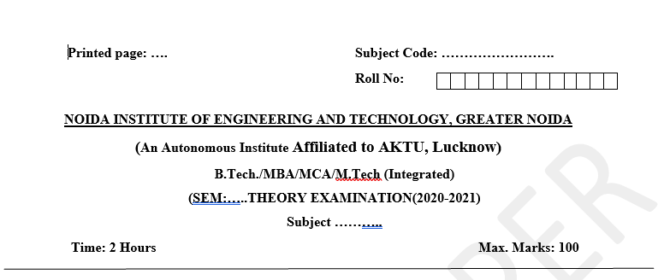
Pattern of External Exam Question Paper

Slide 19
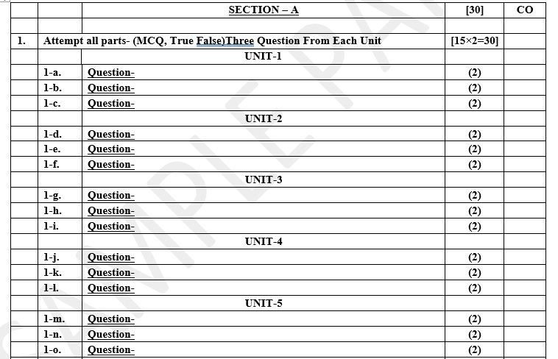
Pattern of External Exam Question Paper

Slide 20
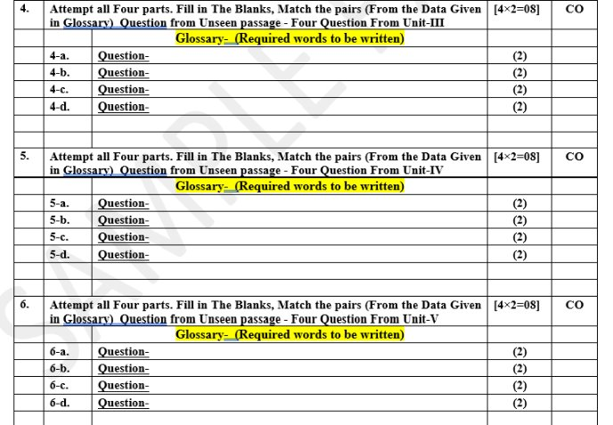
Pattern of External Exam Question Paper

Slide 21
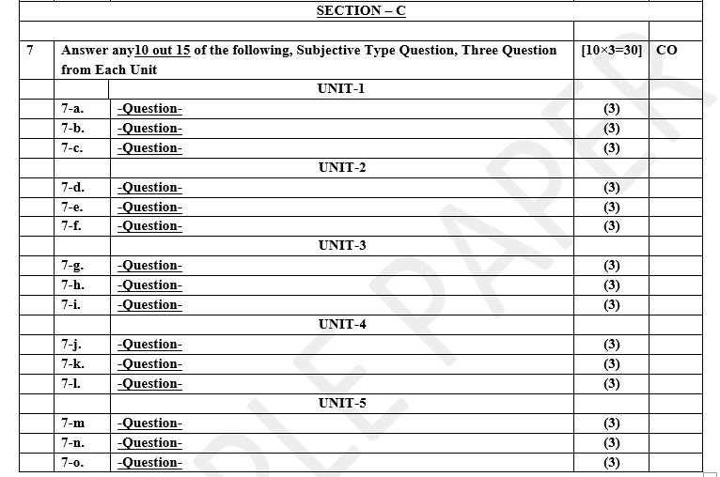
Pattern of External Exam Question Paper

Slide 22
Brief Introduction about the Subject and Videos
Data analytics (DA) is the area of examining data sets in order to find trends and draw conclusions about the information they contain. Increasingly, data analytics is done with the aid of specialized systems and software.
YouTube/other Video Links
https://www.youtube.com/watch?v=KxryzSO1Fjs

Slide 23
Unit Content
Form of Data Pre-processing
data Attribute and its types
understanding and extracting useful variables
KDD process, Data Cleaning
Missing Values
Noisy Data
Discretization and Concept hierarchy generation (Binning, Clustering, Histogram)
Inconsistent Data
Data Integration and Transformation
Data Reduction: Data Cube Aggregation,
Data Compression
Numerosity Reduction.

Slide 24
Unit Objectives
Understand the Data preprocessing.
Understanding data Attribute and its types
Describe a formal definition to its frameworks.
Understanding the concept of understanding and extracting useful variables.

Slide 25
Form of Data Pre-processing
Data Preprocessing
Data preprocessing is a step in the data mining and data analysis process that takes raw data and transforms it into a format that can be understood and analyzed by computers and machine learning.
Raw, real-world data in the form of text, images, video, etc., is messy. Not only may it contain errors and inconsistencies, but it is often incomplete, and doesn’t have a regular, uniform design.
Machines like to process nice and tidy information – they read data as 1s and 0s. So calculating structured data, like whole numbers and percentages is easy. However, unstructured data, in the form of text and images must first be cleaned and formatted before analysis.

Slide 26
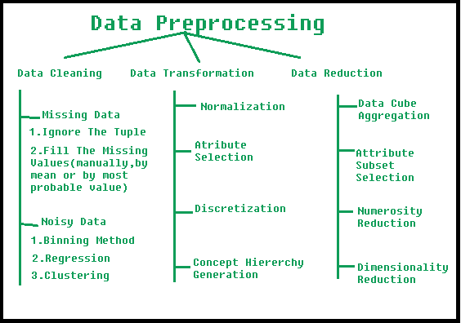
Form of Data Pre-processing

Slide 27
Form of Data Pre-processing
Data Preprocessing Steps
Let’s take a look at the established steps you’ll need to go through to make sure your data is successfully preprocessed.
Data quality assessment
Data cleaning
Data transformation
Data reduction

Slide 28
Form of Data Pre-processing
Data quality assessment is the process of evaluating the completeness, accuracy, consistency, and relevance of data to ensure it is suitable for analysis or decision-making. Good data quality is critical for reliable insights, correct predictions, and informed decisions.
Key Dimensions of Data Quality:
Accuracy:
Definition: The extent to which the data correctly represents the real-world values or facts.
Example: A person's birthdate recorded correctly in a database.
Completeness:
Definition: The degree to which all required data is present.
Example: No missing values for critical fields like customer name or email address.
Consistency:
Definition: Data should be uniform across all systems and sources.
Example: A customer's address recorded consistently across different systems.

Slide 29
Form of Data Pre-processing
Timeliness:
Definition: Data should be up-to-date and available when needed.
Example: Sales data recorded in real-time instead of after a long delay.
Validity:
Definition: Data should conform to a defined set of rules or formats.
Example: A phone number following the correct format (e.g., 10 digits).
Uniqueness:
Definition: No duplicate records should exist within the dataset.
Example: Each customer ID should be unique, with no two records having the same ID.
Relevance:
Definition: The data should be relevant and appropriate for the intended use or analysis.
Example: When analyzing sales performance, only sales data from the correct region or time period should be included.

Slide 30
Form of Data Pre-processing
Steps Involved in Data Preprocessing
Data Cleaning:
The data can have many irrelevant and missing parts. To handle this part, data cleaning is done. It involves handling of missing data, noisy data etc.
Missing Data: This situation arises when some data is missing in the data. It can be handled in various ways. Some of them are:
Ignore the tuples: This approach is suitable only when the dataset we have is quite large and multiple values are missing within a tuple.
Fill the Missing values: There are various ways to do this task. You can choose to fill the missing values manually, by attribute mean or the most probable value.

Slide 31
Form of Data Pre-processing
Noisy Data: Noisy data is a meaningless data that can’t be interpreted by machines. It can be generated due to faulty data collection, data entry errors etc. It can be handled in following ways :
Binning Method: The binning method is a data preprocessing technique used to group or "bin" continuous data into discrete intervals. This method is especially helpful in simplifying data analysis by reducing the number of unique values and handling noise. It's commonly used in statistical analysis, machine learning, and data mining.
Types of Binning Methods
Equal-width Binning:
The range of data is divided into intervals of equal size.
Example: If you have data values from 0 to 100, you can split them into bins of size 10 (e.g., 0–10, 10–20, etc.).

Slide 32
Form of Data Pre-processing
2. Equal-frequency Binning (Quantile Binning):
Each bin contains the same number of data points.
Example: If you have 100 values, you could create 5 bins with 20 values in each.
3. Custom Binning:
You define the boundaries for the bins based on domain knowledge or specific requirements.
Example: For age data, bins could be defined as 0–18, 19–35, 36–60, and 61+.
Regression: Here data can be made smooth by fitting it to a regression function. The regression used may be linear (having one independent variable) or multiple (having multiple independent variables).
Clustering: This approach groups the similar data in a cluster. The outliers may be undetected or it will fall outside the clusters.

Slide 33
Forms of Data Pre-Processing
2. Data transformation
With data cleaning, we’ve already begun to modify our data, but data transformation will begin the process of turning the data into the proper format(s) you’ll need for analysis and other downstream processes.
This generally happens in one or more of the below:
Aggregation
Normalization
Feature selection
Discretization
Concept hierarchy generation

Slide 34
Form of Data Pre-processing
Data Transformation:
This step is taken in order to transform the data in appropriate forms suitable for mining process. This involves following ways:
Data aggregation is the process of gathering and combining data from different sources into a single, unified dataset.
This can involve summarizing, averaging, or organizing data to make it easier to analyze or draw conclusions from.
For example, if you have sales data from different stores, you might aggregate it to find the total sales for all stores combined. Aggregated data helps in simplifying large sets of information for better insights or decision-making
Normalization: It is done in order to scale the data values in a specified range (-1.0 to 1.0 or 0.0 to 1.0)
Attribute Selection: In this strategy, new attributes are constructed from the given set of attributes to help the mining process.
Discretization: This is done to replace the raw values of numeric attribute by interval levels or conceptual levels.
Concept Hierarchy Generation: Here attributes are converted from lower level to higher level in hierarchy. For Example-The attribute “city” can be converted to “country”.

Slide 35
Form of Data Pre-processing
3. Data Reduction:
Data reduction is a crucial step in the data mining process that involves reducing the size of the dataset while preserving the important information. This is done to improve the efficiency of data analysis and to avoid overfitting of the model. Some common steps involved in data reduction are:
Feature Extraction: This involves transforming the data into a lower-dimensional space while preserving the important information.
Feature extraction is often used when the original features are high-dimensional and complex.
It can be done using techniques such as PCA, linear discriminant analysis (LDA), and non-negative matrix factorization (NMF).
Feature Selection: This involves selecting a subset of relevant features from the dataset.
Feature selection is often performed to remove irrelevant or redundant features from the dataset.
It can be done using various techniques such as correlation analysis, mutual information, and principal component analysis (PCA).

Slide 36
Form of Data Pre-processing
Sampling: This involves selecting a subset of data points from the dataset.
Sampling is often used to reduce the size of the dataset while preserving the important information.
It can be done using techniques such as random sampling, stratified sampling, and systematic sampling.
Clustering: This involves grouping similar data points together into clusters.
Clustering is often used to reduce the size of the dataset by replacing similar data points with a representative centroid.
It can be done using techniques such as k-means, hierarchical clustering, and density-based clustering.
Compression: This involves compressing the dataset while preserving the important information. Compression is often used to reduce the size of the dataset for storage and transmission purposes. It can be done using techniques such as wavelet compression, JPEG compression, and gif compression.

Slide 37
Data Attribute and its types
Data Attribute
A data attribute is a specific piece of information associated with a data object (like a record, row, or entity in a database).
It defines some characteristic or property of that data. For example, in a database of students, attributes could be "Name," "Age," "Grade," etc.
Types of Data Attributes:
Nominal (Categorical) Attributes:
These attributes have names or labels and do not have any inherent order.
Examples: Gender (Male, Female), Colors (Red, Blue, Green).
Ordinal Attributes:
These attributes have a meaningful order or ranking, but the differences between them are not measurable.
Examples: Satisfaction Levels (Low, Medium, High), Education Level (High School, Bachelor’s, Master’s).

Slide 38
Data Attribute and its types
3. Numeric Attributes:
a. Discrete: Takes on distinct or separate values (often counts).
Examples: Number of children, Number of cars.
b. Continuous: Can take any value within a range and is often measured.
Examples: Height, Weight, Temperature.
4. Binary Attributes: These have only two possible values.
Examples: True/False, Yes/No, 0/1.
5. Time-Series Attributes: These change over time and are recorded at specific time intervals.
Examples: Stock prices over days, Temperature readings over time.

Slide 39
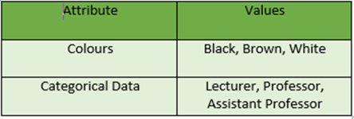
Qualitative Attributes
Qualitative Attributes: Nominal Attributes – related to names: The values of a Nominal attribute are names of things, some kind of symbols. Values of Nominal attributes represents some category or state and that’s why nominal attribute also referred as categorical attributes and there is no order (rank, position) among values of the nominal attribute.

Slide 40
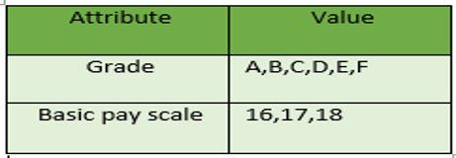
Ordinal Attributes
Ordinal Attributes : The Ordinal Attributes contains values that have a meaningful sequence or ranking(order) between them, but the magnitude between values is not actually known, the order of values that shows what is important but don’t indicate how important it is.

Slide 41
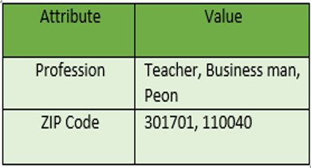
Numeric Attributes
Discrete : Discrete data have finite values it can be numerical and can also be in categorical form. These attributes has finite or countably infinite set of values.

Slide 42
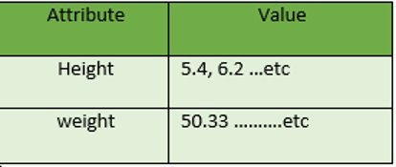
Numeric Attributes
Continuous: Continuous data have an infinite no of states. Continuous data is of float type. There can be many values between 2 and 3. ​

Slide 43
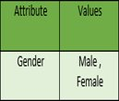
Binary Attributes
Binary Attributes: Binary data has only 2 values/states. For Example yes or no, affected or unaffected, true or false.
Symmetric: Both values are equally important (Gender).
Asymmetric: Both values are not equally important (Result).

Slide 44
Understanding and Extracting Useful Variables
1. Understand the Data:
Domain Knowledge: Understand the context of the data, like what each attribute represents, and its significance in the problem you are solving.
Data Exploration: Use techniques like summary statistics, visualizations (histograms, scatter plots), and correlations to explore relationships and patterns

Slide 45
Understanding and Extracting Useful Variables
2. Feature Selection (Choosing Useful Variables):
Not all variables are equally useful. Feature selection involves choosing variables that are most relevant for the analysis or model.
Filter Methods:
Correlation: Select features that have a strong correlation with the target variable (for regression tasks).
Mutual Information: Select features that have a high mutual information with the target variable (for classification tasks).
Wrapper Methods:
Use machine learning algorithms to test different subsets of features and select the ones that give the best performance. Examples include forward selection and backward elimination.
Embedded Methods:
Algorithms like Lasso Regression or Decision Trees automatically select important features during model training by adding penalties to irrelevant features.

Slide 46
Understanding and Extracting Useful Variables
3. Feature Engineering (Creating New Useful Variables):
Sometimes, raw data isn’t sufficient and needs to be transformed or combined to create new, more useful features.
Binning: Group continuous variables into intervals or "bins" (e.g., age groups).
Polynomial Features: Create new features by raising existing ones to powers (e.g., x2 , x3).
Interaction Terms: Combine two or more features to capture interactions between them.
Date/Time Features: Extract useful information from date/time variables (e.g., extracting the day of the week from a date).

Slide 47
Understanding and Extracting Useful Variables
4. Data Transformation:
Normalization/Standardization: Scale features to a similar range or distribution, especially when using algorithms sensitive to feature scale (e.g., distance-based algorithms like KNN).
Encoding Categorical Variables: Convert categorical attributes into numeric values using techniques like one-hot encoding or label encoding.
5. Dimensionality Reduction (If Too Many Variables):
If there are too many variables, dimensionality reduction techniques can help remove noise and simplify the data.
Principal Component Analysis (PCA): Reduces the number of features by combining them into fewer variables while preserving variance.
t-SNE or UMAP: (t-Distributed Stochastic Neighbour Embedding) and UMAP (Uniform Manifold Approximation and Projection) are two popular techniques used for dimensionality reduction and visualization of high-dimensional data.
Both aim to preserve the structure of the data while reducing the number of dimensions (usually down to 2 or 3 for visualization).

Slide 48
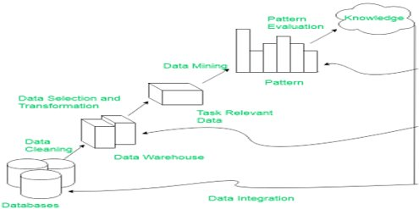
KDD Process
Knowledge discovery in databases (KDD) is the process of discovering useful knowledge from a collection of data.
This widely used data mining technique is a process that includes data preparation and selection, data cleansing, incorporating prior knowledge on data sets and interpreting accurate solutions from the observed results.​

Slide 49
KDD Process
Data Cleaning: Data cleaning is defined as removal of noisy and irrelevant data from collection.
Cleaning in case of Missing values.
Cleaning noisy data, where noise is a random or variance error.
Cleaning with Data discrepancy detection and Data transformation tools.
Data Integration: Data integration is defined as heterogeneous data from multiple sources combined in a common source (Datawarehouse).
Data integration using Data Migration tools.
Data integration using Data Synchronization tools.
Data integration using ETL(Extract-Load-Transformation) process.

Slide 50
KDD Process
Data Selection: Data selection is defined as the process where data relevant to the analysis is decided and retrieved from the data collection.
Data selection using Neural network.
Data selection using Decision Trees.
Data selection using Naive bayes.
Data selection using Clustering, Regression, etc.
Data Transformation: Data Transformation is defined as the process of transforming data into appropriate form required by mining procedure.
Data Transformation is a two step process:
Data Mapping: Assigning elements from source base to destination to capture transformations.
Code generation: Creation of the actual transformation program.

Slide 51
KDD Process
Data Mining: Data mining is defined as clever techniques that are applied to extract patterns potentially useful.
Transforms task relevant data into patterns.
Decides purpose of model using classification or characterization.
Pattern Evaluation: Pattern Evaluation is defined as identifying strictly increasing patterns representing knowledge based on given measures.
Find interestingness score of each pattern.
Uses summarization and Visualization to make data understandable by user.

Slide 52
Data Cleaning
Data Cleaning: ​ The data can have many irrelevant and missing parts. To handle this part, data cleaning is done. It involves handling of missing data, noisy data etc. ​ ​
Missing Data: ​ This situation arises when some data is missing in the data. It can be handled in various ways. ​ Some of them are: ​
Ignore the tuples: ​ This approach is suitable only when the dataset we have is quite large and multiple values are missing within a tuple. ​ ​
Fill the Missing values: ​ There are various ways to do this task. You can choose to fill the missing values manually, by attribute mean or the most probable value. ​

Slide 53
Data Cleaning
Noisy Data: Noisy data is a meaningless data that can’t be interpreted by machines. It can be generated due to faulty data collection, data entry errors etc. It can be handled in following ways :
Binning Method: This method works on sorted data in order to smooth it.
The whole data is divided into segments of equal size and then various methods are performed to complete the task. Each segmented is handled separately.
One can replace all data in a segment by its mean or boundary values can be used to complete the task.
Regression: Here data can be made smooth by fitting it to a regression function.
The regression used may be linear (having one independent variable) or multiple (having multiple independent variables).
Clustering: This approach groups the similar data in a cluster.
The outliers may be undetected or it will fall outside the clusters.

Slide 54
Discretization and Concept Hierarchy Generation
Discretization:
Discretization is the process of converting continuous data (data that can take any value within a range, like height, weight, or temperature) into discrete categories or intervals.
For example:
A continuous attribute like "age" could be discretized into categories such as "child (0-12)", "teen (13-19)", "adult (20-64)", and "senior (65+)".
Common Methods of Discretization:
Equal-width binning: Divides the data range into intervals of equal size (e.g., ages 0-10, 11-20, 21-30, etc.).
Equal-frequency binning: Divides data into intervals so that each bin contains roughly the same number of data points.
Clustering-based: Uses clustering algorithms like k-means to group similar data points into bins.
Decision tree-based: Uses decision tree algorithms to find the best splits to create categories.
Discretization helps in simplifying complex data and makes it easier to apply algorithms that require categorical inputs.

Slide 55
Discretization and Concept Hierarchy Generation
Concept Hierarchy Generation:
This technique allows data to be grouped into a hierarchy.
For example:
For a geographic attribute like "city," a concept hierarchy might be: City → State → Country → Continent.
For a numerical attribute like "salary," it might be: Salary → Low, Medium, High.
Concept hierarchies are useful for performing OLAP (Online Analytical Processing) operations like "drill-up" or "drill-down." These operations allow analysts to zoom in on specific data points or zoom out to get a more general view.
Ways to Generate Concept Hierarchies:
Predefined hierarchies: Some data attributes naturally follow a hierarchy, such as dates (day → month → year) or geographic data.
Data-driven approaches: Hierarchies can also be generated based on the data itself, by grouping and generalizing values (e.g., binning salaries into "low", "medium", and "high").

Slide 56
Data Consistency
Data consistency refers to the accuracy, reliability, and uniformity of data across different systems, databases, or datasets.
When data is consistent, it means that the same data values are presented in the same way across different platforms or contexts, ensuring that there are no contradictions or conflicts.
Why is Data Consistency Important?
Data consistency is crucial for:
Accurate Analysis: Inconsistent data can lead to faulty conclusions in data analysis, reporting, or decision-making.
Data Integrity: Ensures that the data remains valid and reliable throughout its lifecycle.
Data Synchronization: Helps maintain uniformity when multiple databases or systems are used (e.g., across distributed systems).

Slide 57
Data Consistency
Types of Data Consistency:
Syntactic Consistency: Ensures that the data follows the same format or structure (e.g., dates are always entered as "YYYY-MM-DD").
Semantic Consistency: Ensures that data meanings are consistent across all datasets (e.g., using "Male/Female" in one system and "M/F" in another would be inconsistent).
Temporal Consistency: Ensures that data is up-to-date and synchronized across systems, particularly in distributed environments.

Slide 58
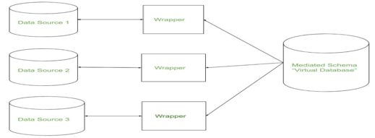
Integration and Transformation
“Data Integration is a data preprocessing technique that involves combining data from multiple heterogeneous data sources into a coherent data store and provide a unified view of the data. These sources may include multiple data cubes, databases, or flat files.”
​

Slide 59
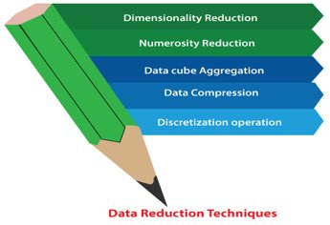
Data Reduction
“Data reduction techniques ensure the integrity of data while reducing the data.
Data reduction is a process that reduces the volume of original data and represents it in a much smaller volume.
Data reduction techniques are used to obtain a reduced representation of the dataset that is much smaller in volume by maintaining the integrity of the original data.”
​
Data Reduction Technique:
Data Cube Aggregation,
Data Compression,
Numerosity Reduction

Slide 60
Data Reduction Technique
Data Cube Aggregation is a data processing technique used in data warehousing and OLAP (Online Analytical Processing) to summarize data across multiple dimensions, creating a data cube that allows for multi-dimensional analysis.
It is especially useful when dealing with large datasets, as it enables users to explore data from different perspectives (e.g., sales over time, by region, and by product).
What is a Data Cube?
A data cube is a multi-dimensional array of data where:
Dimensions: These represent the different perspectives or attributes by which the data is analyzed.
For example, in a sales dataset, dimensions could be time, region, and product.
Measures: These are the actual numerical values being analyzed, like sales amount, profit, or revenue.
Each cell in a data cube contains aggregated data that corresponds to a particular combination of dimension values.

Slide 61
Data Reduction Technique
Example of Data Cube Aggregation:
Imagine you have a dataset that tracks product sales over time, across different regions, and for various product categories. If you want to see the total sales for a specific region over a month, data cube aggregation can help by summarizing (aggregating) the sales data according to your chosen dimensions.
Dimensions: Time, Region, Product
Measure: Total Sales
Benefits of Data Cube Aggregation:
Faster Analysis: Aggregated data allows analysts to retrieve summaries quickly without scanning through the entire dataset.
Multi-Dimensional View: Data cubes support viewing the data from various angles (time, location, category), making it easier to uncover patterns and trends.
Summarization: It provides summarized information at different levels of granularity, making data more digestible and actionable.

Slide 62
Data Reduction Technique
Use Cases:
Business Intelligence: Data cube aggregation is widely used in reporting and dashboards for business intelligence systems. For example, an e-commerce company may use a data cube to analyze product sales by time period, region, and customer demographic.
Financial Analysis: Data cubes can be used to aggregate financial data (e.g., total revenue by department, by year, by region).
Inventory Management: Aggregating stock levels across different warehouses, regions, or time periods to analyze supply chain performance

Slide 63
Data Reduction Technique
Data compression is a data reduction technique that aims to reduce the size of data while maintaining its essential information. This process decreases the storage space or bandwidth required to store or transmit data, making it more efficient for various tasks like data storage, transfer, or processing.
Types of Data Compression:
Lossless Compression:
Goal: Reduce file size without losing any information.
Method: Data is compressed in such a way that the original data can be perfectly reconstructed from the compressed data.
Examples:
Huffman Coding: Encodes frequently occurring data with shorter codes to reduce size.
Run-length Encoding (RLE): Compresses sequences of repeated values by storing them as a single value and count (e.g., "AAA" becomes "3A").
ZIP, PNG: File formats that use lossless compression.
Use cases: Text files, financial data, medical imaging, or any situation where exact reproduction of data is essential.

Slide 64
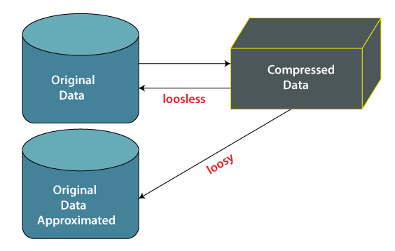
Data Reduction Technique

Slide 65
Data Reduction Technique
2. Lossy Compression:
Goal: Significantly reduce file size, but at the cost of some data loss. The decompressed data may not be identical to the original but is often close enough for practical use.
Method: Compresses data by removing less important or redundant information.
Examples:
JPEG: Used for image compression, where some detail is lost to reduce the file size.
MP3: Audio compression that removes frequencies not easily detectable by human hearing.
MPEG: Video compression format that reduces file size by removing non-essential visual information.
Use cases: Images, audio, and video files where some quality loss is acceptable to save significant space.

Slide 66
Data Reduction Technique
Benefits of Data Compression:
Reduced Storage Costs: Compressing data reduces the amount of storage needed to hold files, helping organizations save costs on data storage hardware and cloud storage.
Faster Data Transfer: Compressed data requires less bandwidth, making it quicker to send files over the internet or networks.
Improved Processing Efficiency: Large datasets that are compressed take less time to read and process, improving the efficiency of computational tasks

Slide 67
Data Reduction Technique
Numerosity Reduction is a data reduction technique used to reduce the amount of data by representing the dataset in a smaller form without compromising essential patterns or trends.
This method helps in simplifying and reducing data size, making it easier and faster for algorithms to process and analyze data, particularly for large datasets.
What is Numerosity Reduction?
Numerosity reduction reduces the number of data points or data dimensions by either:
Parametric Methods: Summarizing the data using a model with a fixed number of parameters.
Non-parametric Methods: Approximating the data using smaller, representative subsets.
The goal is to maintain the essence of the original data, but with fewer values, thus reducing the computational cost and storage requirements for analysis.

Slide 68
Weekly/Monthly Assignment
What is Data Pre-processing?
What is Data cleaning?
Explain KDD process.
What is Data Reduction?
What is Data Discretization?
Explain Dimensionality Reduction.
What is Inconsistency of Data?
What is Outliers?
Explain Binning Techniques.
What is Data Cube aggregation?

Slide 69
Glossary Questions
Explain KDD process with Diagram.
2.Explain Data Reduction Techniques.
3.What is Data preprocessing?
4.What is Data Integration?
5.Differentiate Loose Coupling and Loose Coupling approaches of Data Integration.
6.What is Data Transformation?Why it is needed?
7.What are the benefits of Data Reduction?
8.What is Binning?
9.What is Data Aggregation?
10.Write Short notes on:
Discretization Operation
Data Cleaning
Histogram
Data Compression

Slide 70
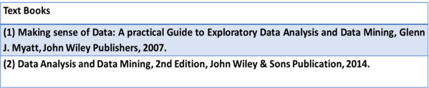
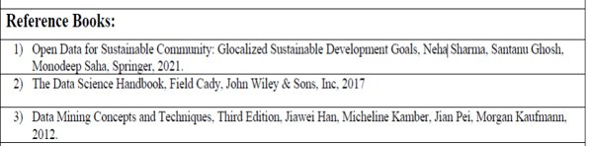
References

Slide 71
1.Explain Form of Data Pre-processing.
2.Explain Data Attribute and its types
3. Explain the techniques how to extract useful variables.
4.Explain KDD process with Diagram.
5.Explain Data Cleaning techniques.
6.Explain Missing Values and Noisy Data.
8.Explain Binning techniques .
9.What is Data Reduction?
10.Write short Notes on:
Data Cube Aggregation,
Data Compression
Numerosity Reduction.
Expected Questions for End Semester Exam

